Slide 1

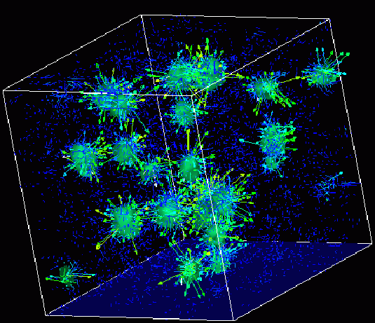

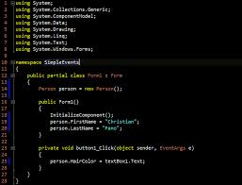
Survey of
Scientific Computing
(SciComp 301)
Dave Biersach
Brookhaven National Laboratory
dbiersach@bnl.gov
Session 23
Difference Tables,
Least Squares

Slide 2
Session Goals
Determine the exact formula of the underlying generator for a sequence of integers (a functional equation)
Fit a quadratic curve to a set of observations to interpolate resulting values that lie between the observations
Understand how to create difference tables in the open source (and free) LibreOffice Calc spreadsheet program
Appreciate % relative error as a measure of goodness of fit of a model to experimental data
Fit a curve using the Method of Least Squares
Derive the least squares equations using the partial derivatives for each coefficient of the unknown quadratic

Slide 3
Creating a Spreadsheet
A spreadsheet is a flexible computing tool that allows you to enter data and write formulas to operate on that data
Everything is based on the concept of a “cell” that has a unique column (letter) and row (number) address
A formula entered in one cell can reference data in one ore more other cells by using a cell addresses, or by using a range of cell addresses
When source data cells are update, the spreadsheet automatically recalculates all dependent formula cells
Graphs can be created to depict the values in cells

Slide 4

Creating a Spreadsheet
Click icon to launch LibreOffice “Calc” spreadsheet

Slide 5
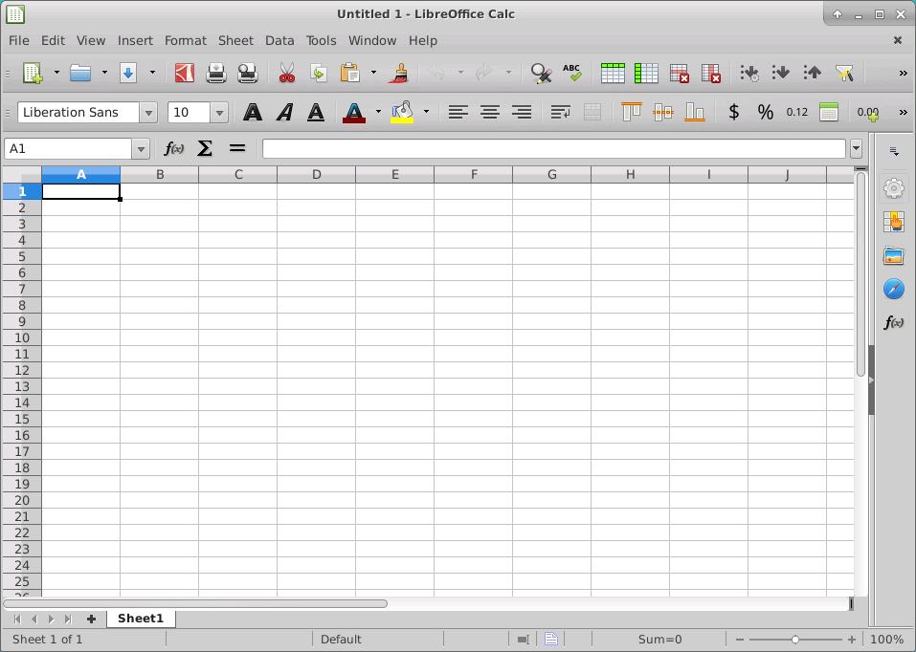
Lab 1 - Creating a Spreadsheet
This is cell A1

Slide 6
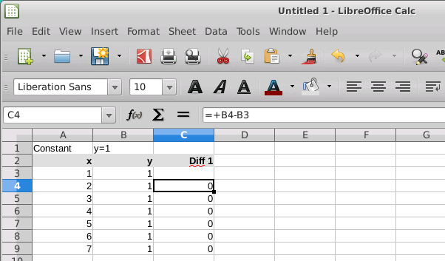
Lab 1 - Creating a Spreadsheet
Bold, Italic, Underline a cell
Left, Center, Right Justify a cell
Cell C4 is a formula using relative cell addresses

Slide 7
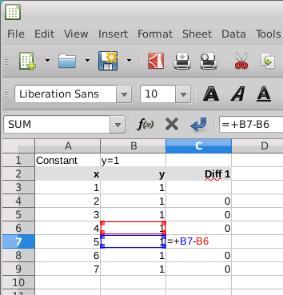
Lab 1 - Creating a Spreadsheet
To check a formula cell, hit F2 to edit the formula – color coding identifies the cells

Slide 8
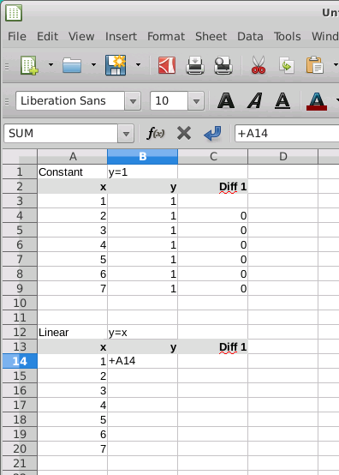
Lab 1 – Creating a Spreadsheet
To enter a formula cell, press +, then use the arrow keys to select the source data cells. Press ENTER when done with the formula

Slide 9
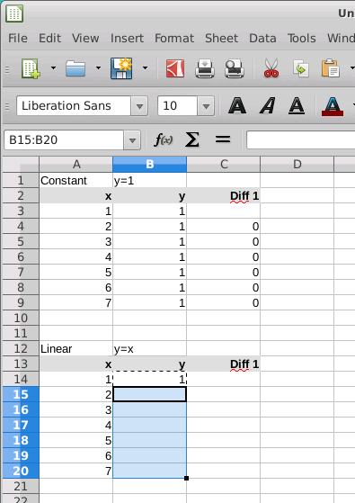
Lab 1 - Creating a Spreadsheet
To copy a formula to other cells, highlight the source cell, press “Control + C” to copy, then use arrow keys + SHIFT to highlight a destination range, and press ENTER to paste

Slide 10
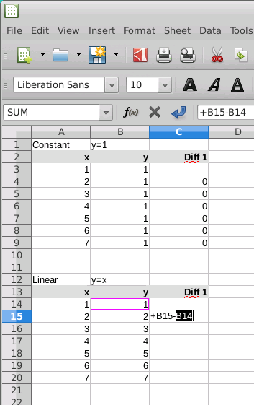
Lab 1 - Creating a Spreadsheet
Create the Diff 1 column using the difference between the left-adjacent cell and the cell above that one. Then copy that formula down the remaining cells in the Diff 1 column.

Slide 11
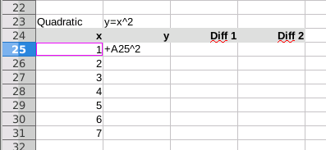
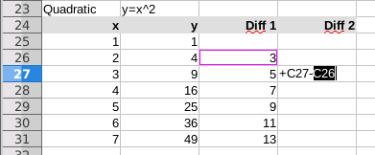
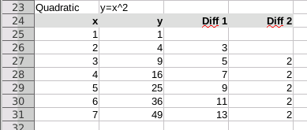
Lab 1 - Creating a Spreadsheet
Create the y column with the exponent 2 and then copy down
Add the Diff 1 & Diff 2 columns and formulas and then copy down
The completed quadratic difference table

Slide 12
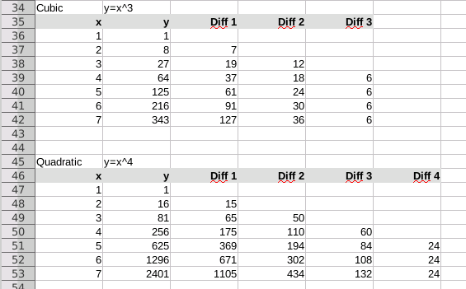
Lab 1 - Creating a Spreadsheet
Finish the Cubic and Quartic Difference Tables

Slide 13
Difference Tables
A difference table calculates the gap between successive values of a given function
For every higher power of the independent variable (the domain) we add another difference column
Difference column #2 is the gap between successive values of difference column #1
We keep adding difference columns until the row values achieve a steady state: they are the same for each row
The cubic table needed 3 difference columns – the quartic table needed 4 difference columns to achieve steady state

Slide 14
Difference Tables
Keep adding difference columns until the rightmost column reaches a steady value

Slide 15
Difference Tables – What They Reveal

Slide 16
Difference Tables – What They Reveal
If we believe a given a set of observations obeys a general underlying law but remains an unknown specific formula, we can use difference tables to systematically reveal the set’s hidden functional equation (the generator)
We start by “guessing” the highest power of x that would likely be in the underlying generator
We compare the expected steady state values for each power of x with the our observed values
As we determine the coefficient of each decreasing power of x, we begin to expose the underlying functional equation that originally generated the sequence

Slide 17
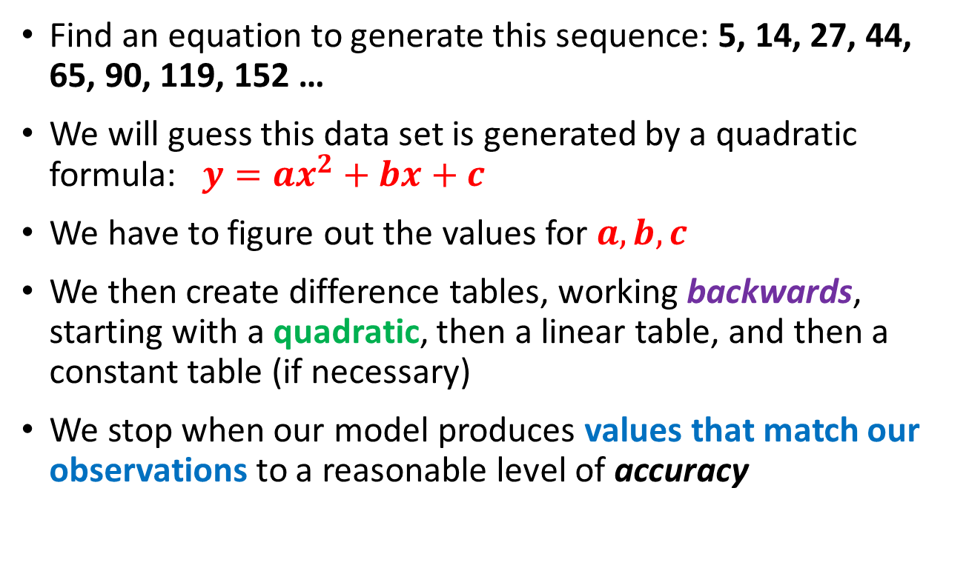
Lab 2
Find an equation to generate this sequence: 5, 14, 27, 44, 65, 90, 119, 152 …
We will guess this data set is generated by a quadratic formula: $y=ax^{2}+bx+c$
We have to figure out the values for $a,b, c$
We then create difference tables, working backwards, starting with a quadratic, then a linear table, and then a constant table (if necessary)
We stop when our model produces values that match our observations to a reasonable level of accuracy

Slide 18
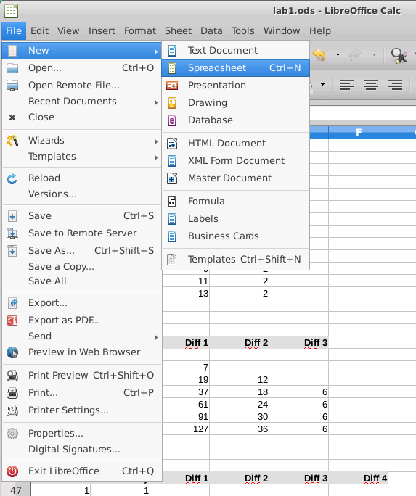
Lab 2 – Create a new Spreadsheet

Slide 19
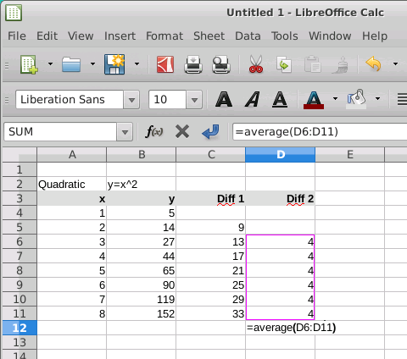
Calculating the Mean Steady Difference
Enter =AVERAGE then select the range of cells to include in the average – for every table always put the average cell at the bottom row under the last difference column
The B column holds your observations

Slide 20
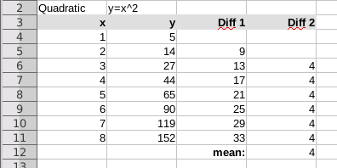
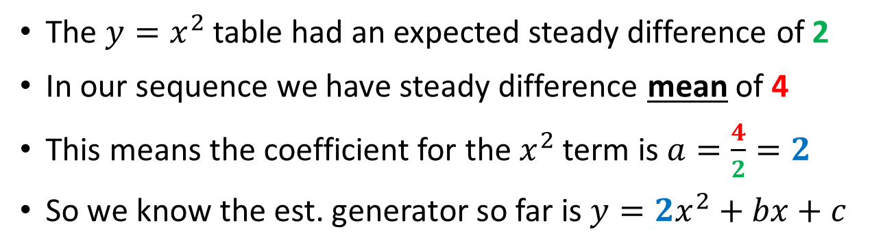
Mean Difference = Term’s Coefficient
The $y=x^{2}$ table had an expected steady difference of 2
In our sequence we have steady difference mean of 4
This means the coefficient for the $x^{2}$ term is $a=\frac{4}{2}=2$
So we know the est. generator so far is $y=2x^{2}+bx+c$

Slide 21
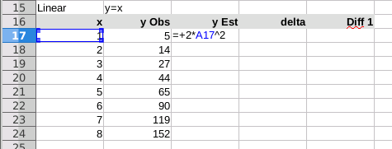
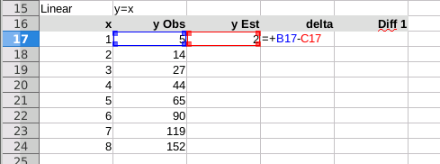
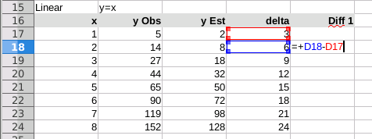
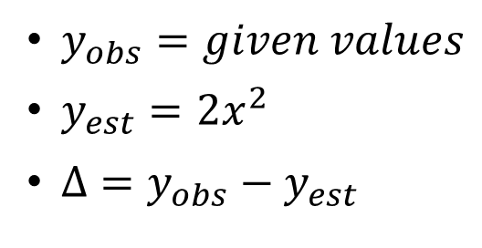
Delta = Observed - Expected
$y_{obs}=given values$
$y_{est}=2x^{2}$
$Δ=y_{obs}−y_{est}$
Add the Diff 1 column and formula, then copy down all rows

Slide 22
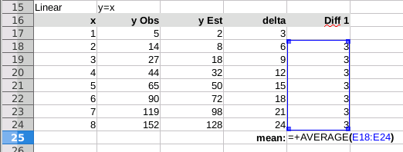
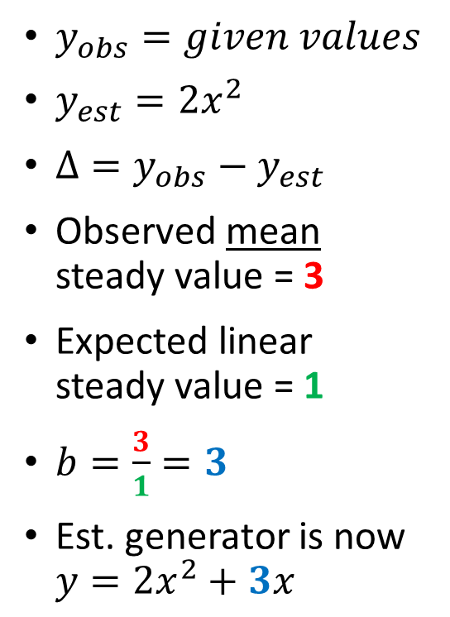
Delta = Observed - Expected
$y_{obs}=given values$
$y_{est}=2x^{2}$
$Δ=y_{obs}−y_{est}$
Observed mean steady value = 3
Expected linear steady value = 1
$b=\frac{3}{1}=3$
Est. generator is now $y={2x}^{2}+3x$

Slide 23
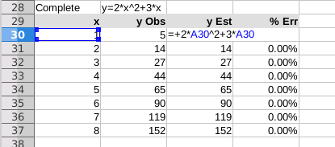
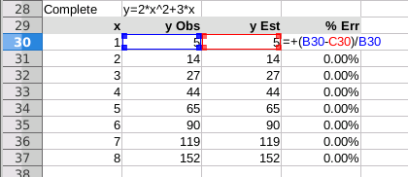
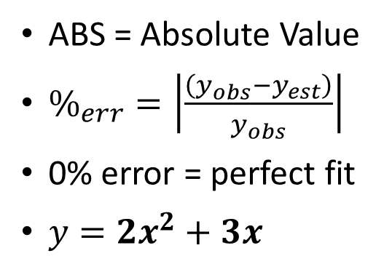
% Relative Error
ABS = Absolute Value
$\%_{err}=\left|\frac{\left(y_{obs}−y_{est}\right)}{y_{obs}}\right|$
0% error = perfect fit
$y=2x^{2}+3x$
Remember to add any final constant term to the estimated y function

Slide 24
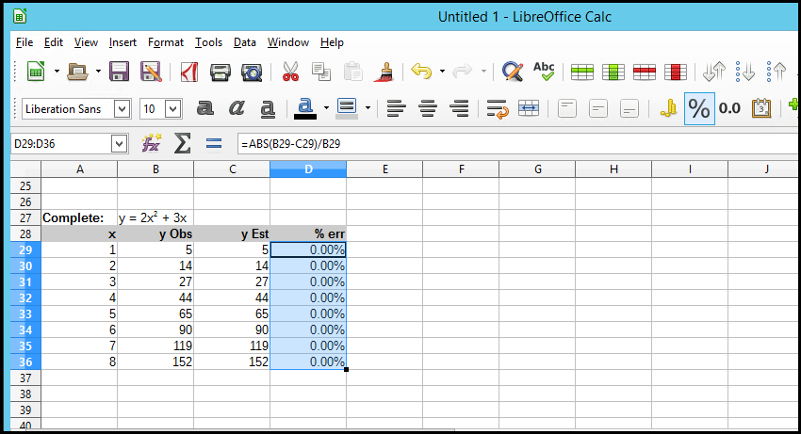
Changing Cell Number Format
Highlight a range and click the % icon to format the numbers as percentages

Slide 25
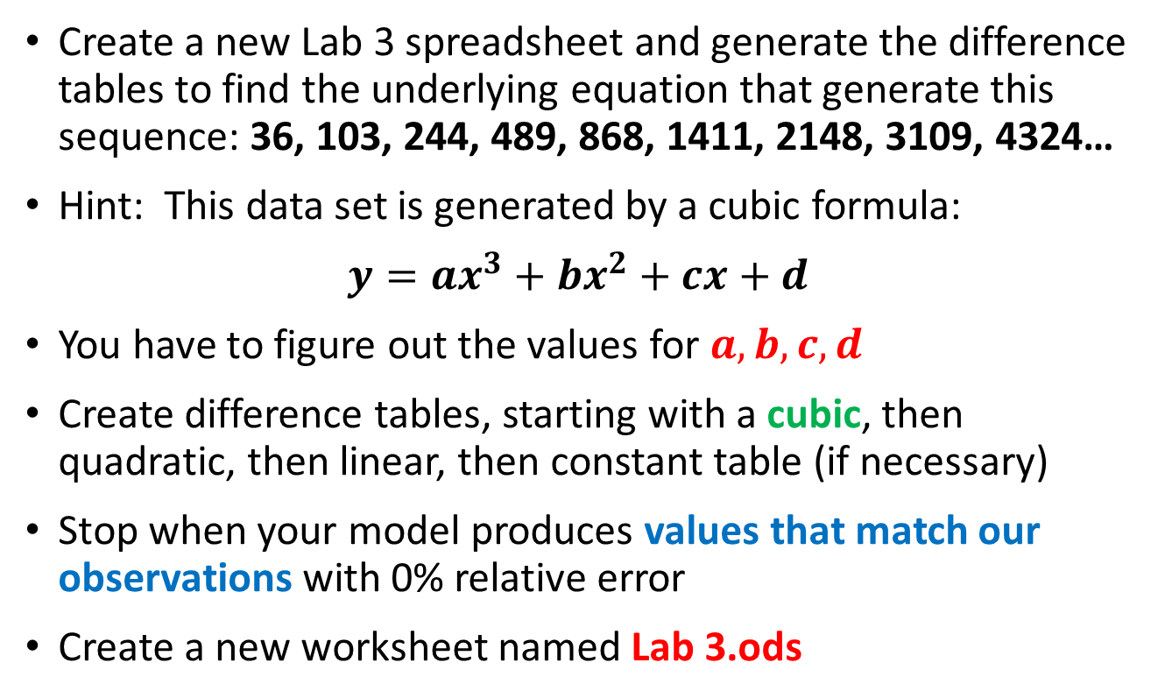
Lab 3
Create a new Lab 3 spreadsheet and generate the difference tables to find the underlying equation that generate this sequence: 36, 103, 244, 489, 868, 1411, 2148, 3109, 4324…
Hint: This data set is generated by a cubic formula:
$$y=ax^{3}+bx^{2}+cx+d$$
You have to figure out the values for $a,b, c,d$
Create difference tables, starting with a cubic, then quadratic, then linear, then constant table (if necessary)
Stop when your model produces values that match our observations with 0% relative error
Create a new worksheet named Lab 3.ods

Slide 26
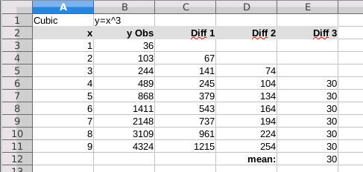

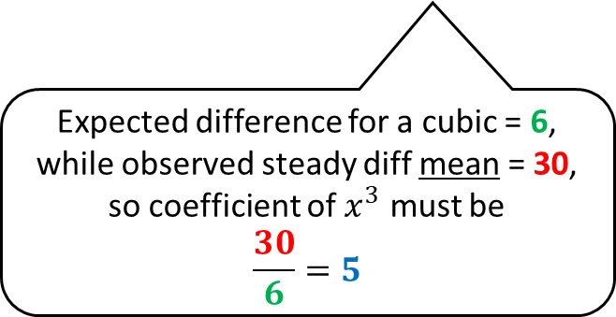
Lab 3
Expected difference for a cubic = 6, while observed steady diff mean = 30, so coefficient of $x^{3}$ must be
$$\frac{30}{6}=5$$
So far $… y=5x^{3}+bx^{2}+cx+d$

Slide 27
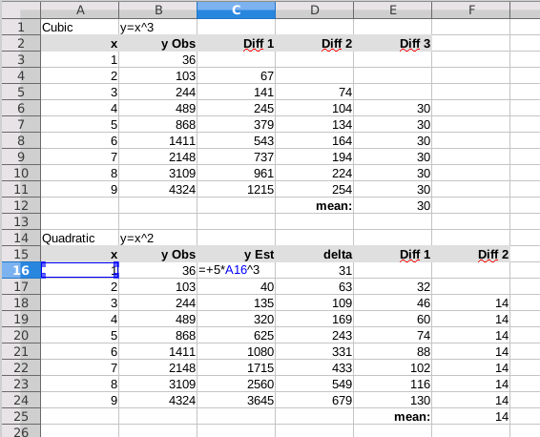

Lab 3
Expected difference for a quadratic = 2, while observed steady diff mean = 14, so coefficient of $x^{2}$ must be
$$\frac{14}{2}=7$$
Now so far $… y=5x^{3}+7x^{2}+cx+d$

Slide 28
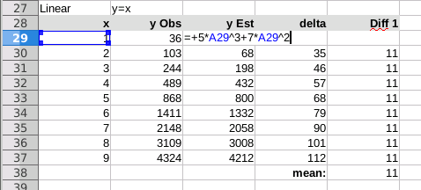

Lab 3
Remember to add the new quadratic term to the estimated y function
Steady difference for a linear = 1, while observed steady diff mean = 11, so coefficient of $x^{2}$ must be
$$\frac{11}{1}=11$$
Now so far $… y=5x^{3}+7x^{2}+11x+d$

Slide 29
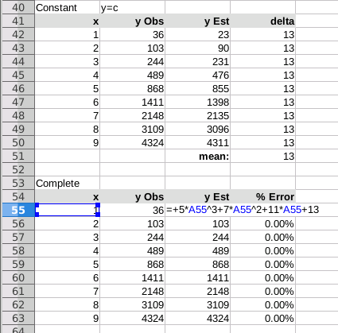
Lab 3
If delta values are all the same, then that value is the final constant term
$$Functional Equation$$
$$y=5x^{3}+7x^{2}+11x+13$$
$$with x∈ℤ^{+}$$
Generates the sequence:
36, 103, 244, 489, 868, 1411, 2148, 3109, 4324…

Slide 30

Lab 4
This case study will use data from an experiment that measured the counter on a tape machine vs. the elapsed time the tape had been played
Ideally this would be a linear relationship – but due to the changing circumference of a tape reel as it is played, the drive motor does not maintain consistent timing, so it is non-linear

Slide 31
Lab 4
Find an equation to model a tape counter as a function of playing time
X value is the number of 10 minute blocks the tape has been playing from the beginning
Y value is the counter on the tape player (linear feet)
With a good fitting model we can answer questions like: Where should we stop the tape to be 65 minutes into the recording?

Slide 32
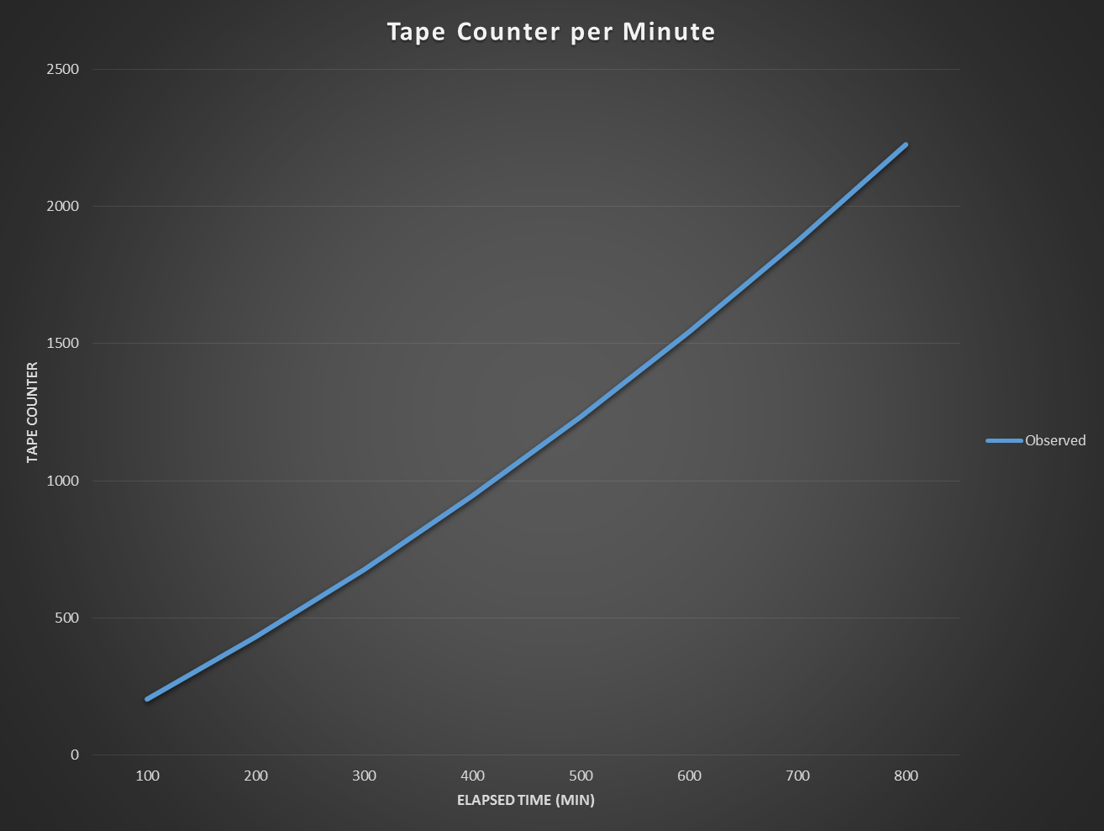
Lab 4
$$Assume$$
$$y=ax^{2}+bx+c$$

Slide 33
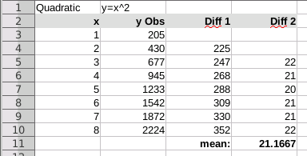
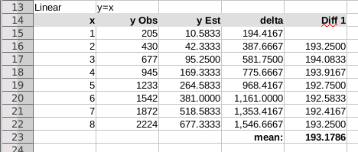
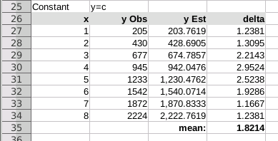
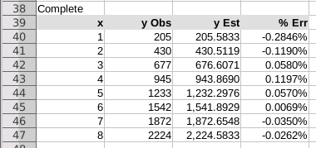
Lab 4
$$y_{est}=10.5833x^{2}+193.1786x+1.8214$$

Slide 34
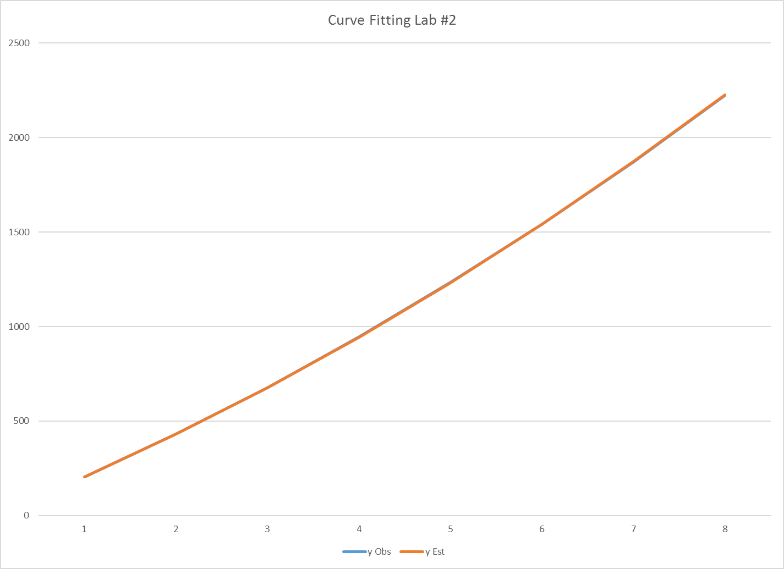
Lab 4
$$y=10.5833x^{2}+193.1786x+1.8214$$
1704
Where should I stop the tape to be exactly 65 minutes into the recording?
$$10.5833{\left(6.5\right)}^{2}+193.1786\left(6.5\right)+1.8214=1704$$

Slide 35
Lab 5 - Method of Least Squares
Developed by Gauss, least squares finds the coefficients of a polynomial of a given degree that approximates a set of observations with minimal variance from the data
The modeler selects a curve whose general shape matches the trend of the data
The partial derivatives of the chosen polynomial are then determined which leads to a system of linear equations that can be solved using matrices and Cramer’s Rule
The coefficients of each term of the model polynomial can then be determined to allow us to estimate the unknown function values

Slide 36
Lab 5 - Method of Least Squares
$$Assume$$
$$y=ax^{2}+bx+c$$

Slide 37
Lab 5 - Method of Least Squares
$$Minimize S= \sum_{i=1}^{n}{{\left[y_{i}−\left(ax_{i}^{2}+bx_{i}+c\right)\right]}^{2}}$$
$$\left(y−{ax}^{2}−bx−c\right)\left(y−{ax}^{2}−bx−c\right)$$
$$y^{2}−ax^{2}y−bxy−cy$$
$$−ax^{2}y +a^{2}x^{4}+abx^{3}+acx^{2}$$
$$−bxy +abx^{3} +b^{2}x^{2}+bcx$$
$$−cy +acx^{2} +bcx+c^{2}$$
$$S=y^{2}−2ax^{2}y−2bxy−2cy+a^{2}x^{4}+2abx^{3}+2acx^{2}+b^{2}x^{2}+2bcx+c^{2}$$

Slide 38
Lab 5 - Method of Least Squares
$$Minimize S= \sum_{i=1}^{n}{{\left[y_{i}−\left(ax_{i}^{2}+bx_{i}+c\right)\right]}^{2}}$$
$$S=y^{2}−2ax^{2}y−2bxy−2cy+a^{2}x^{4}+2abx^{3}+2acx^{2}+b^{2}x^{2}+2bcx+c^{2}$$
For S to have a minimum, these partial derivatives must exist:
$$\frac{∂S}{∂a}=0,\frac{∂S}{∂b}=0,\frac{∂S}{∂c}=0$$
$$\frac{∂S}{∂a}=−2x^{2}y+2ax^{4}+2bx^{3}+2cx^{2}=0$$
$$\frac{∂S}{∂b}=−2xy+2ax^{3}+2bx^{2}+2cx=0$$
$$\frac{∂S}{∂c}=−2y+2ax^{2}+2bx+2c=0$$

Slide 39
Lab 5 - Method of Least Squares
$$Minimize S= \sum_{i=1}^{n}{{\left[y_{i}−\left(ax_{i}^{2}+bx_{i}+c\right)\right]}^{2}}$$
$$\frac{∂S}{∂a}=−2x^{2}y+2ax^{4}+2bx^{3}+2cx^{2}=0$$
$$\left(x^{4}\right)a+\left(x^{3}\right)b+\left(x^{2}\right)c=x^{2}y$$
$$\frac{∂S}{∂b}=−2xy+2ax^{3}+2bx^{2}+2cx=0$$
$$\left(x^{3}\right)a+\left(x^{2}\right)b+\left(x\right)c=xy$$
$$\frac{∂S}{∂c}=−2y+2ax^{2}+2bx+2c=0$$
$$\left(x^{2}\right)a+\left(x\right)b+c=y$$

Slide 40
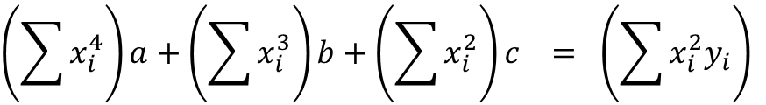
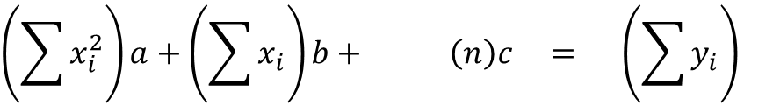
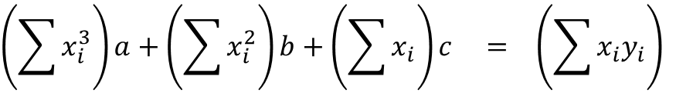
Lab 5 - Method of Least Squares
$$Minimize S= \sum_{i=1}^{n}{{\left[y_{i}−\left(ax_{i}^{2}+bx_{i}+c\right)\right]}^{2}}$$
This is a system of 3 linear equations and 3 unknowns!
$$\left(\sum{x_{i}^{4}}\right)a+\left(\sum{x_{i}^{3}}\right)b+\left(\sum{x_{i}^{2}}\right)c = \left(\sum{x_{i}^{2}y_{i}}\right)$$
$$\left(\sum{x_{i}^{3}}\right)a+\left(\sum{x_{i}^{2}}\right)b+\left(\sum{x_{i}}\right)c = \left(\sum{x_{i}y_{i}}\right)$$
$$\left(\sum{x_{i}^{2}}\right)a+\left(\sum{x_{i}}\right)b+ \left(n\right)c = \left(\sum{y_{i}}\right)$$

Slide 41
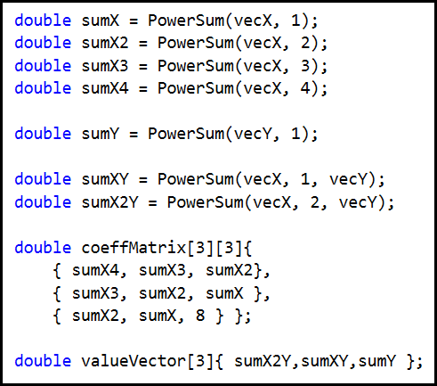
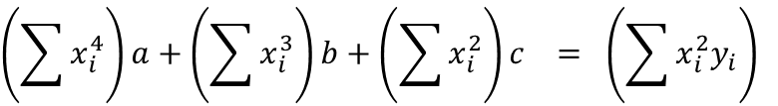
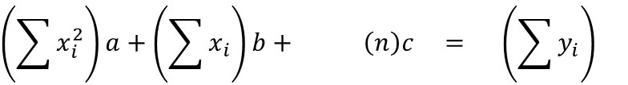
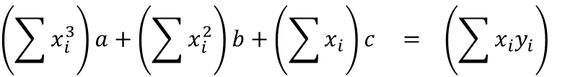
Open Lab 5 - Method of Least Squares
$$Minimize S= \sum_{i=1}^{n}{{\left[y_{i}−\left(ax_{i}^{2}+bx_{i}+c\right)\right]}^{2}}$$
$$\left(\sum{x_{i}^{4}}\right)a+\left(\sum{x_{i}^{3}}\right)b+\left(\sum{x_{i}^{2}}\right)c = \left(\sum{x_{i}^{2}y_{i}}\right)$$
$$\left(\sum{x_{i}^{3}}\right)a+\left(\sum{x_{i}^{2}}\right)b+\left(\sum{x_{i}}\right)c = \left(\sum{x_{i}y_{i}}\right)$$
$$\left(\sum{x_{i}^{2}}\right)a+\left(\sum{x_{i}}\right)b+ \left(n\right)c = \left(\sum{y_{i}}\right)$$
We have 8 sample points in the Lab 5 data set

Slide 42
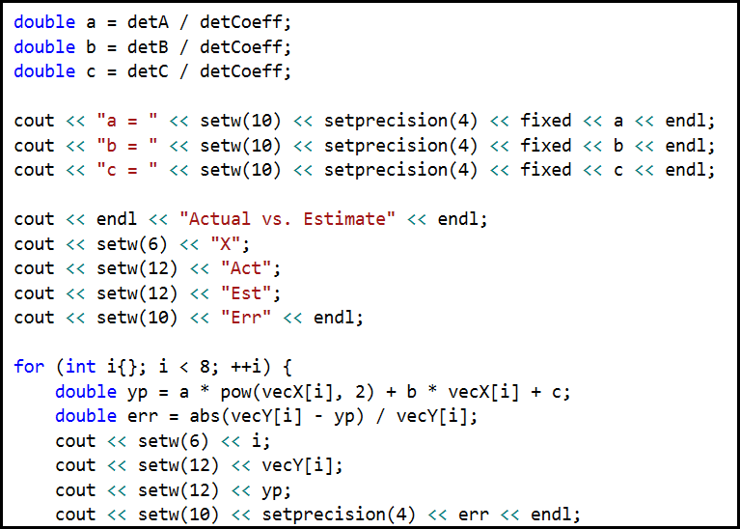

View Lab 5 - Method of Least Squares
$$y=ax^{2}+bx+c$$

Slide 43
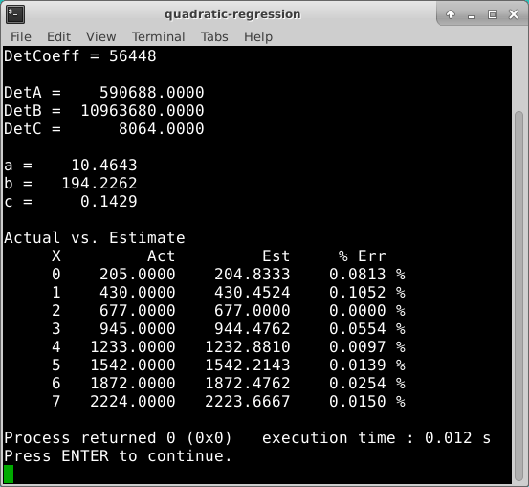
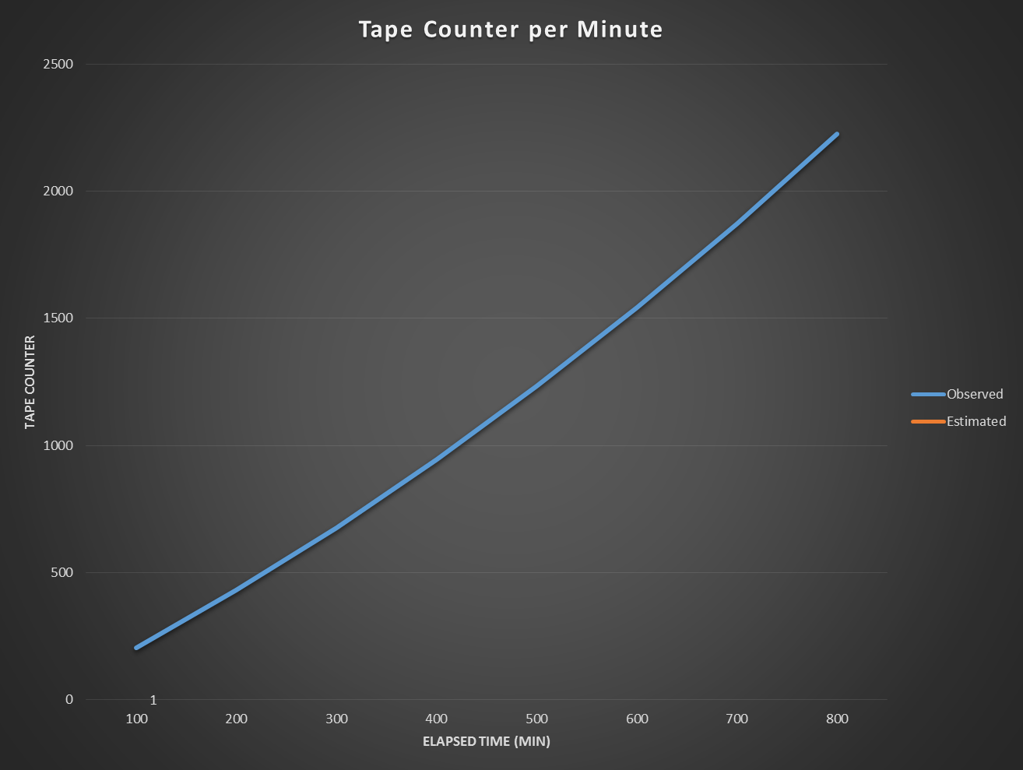
Run Lab 5 - Method of Least Squares
$$y=10.4643x^{2}+194.2262x+0.1429$$

Slide 44
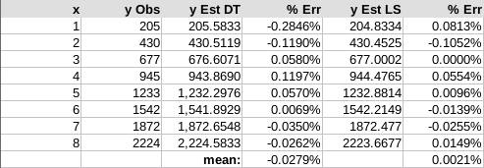
Verify Lab 5 - Method of Least Squares
via Difference Tables
via Least Squares
$$y=10.5833x^{2}+193.1786x+1.8214$$
$$y=10.4643x^{2}+194.2262x+0.1429$$
The method of least squares guarantees the tightest possible fit between the observed data and the polynomial form chosen to model the data

Slide 45
Now you know…
Model fitting starts by assuming the degree of an appropriate curve that reasonably matches the data
How to create difference tables for constant, linear, quadratic, cubic, and quartic terms along with their expected average
Gauss’s “Method of Least Squares” refers to shaping the approximating curve to minimize the total deviations between the observed data and points on that curve
The function to minimize must be expanded, and then partial derivatives must be found for each coefficient of the curve
The % relative error measures the “goodness of fit” of a model to experimental observations

